Slide 1

A Brief Introduction to
Richard Johansen
October 8th, 2018
https://www.teleanalysis.com/wp-content/uploads/2017/08/Tableau-software-logo-e1502871850906.png

Slide 2
Workshop Agenda
What is Tableau?
Understanding Data
Data Visualizations
Work in Tableau Desktop (Public)

Slide 3
What is Tableau?
Tableau is a powerful business intelligence and data visualization software.
“Beefed” up Microsoft Excel
Pros:
Powerful & Versatile
Extremely data-friendly
User-friendly drag & click interface
Excellent for data exploration and report generation
Cons:
Expensive
Moderate learning curve
Speed (large data sets)
Data Security (public version)
Limited Reproducibility

Slide 4
What is Data?
Data is a collection of objects defined by attributes
An attribute is a property or characteristic of an object
Examples: eye color of a person, temperature, etc.
Synonyms: Columns, variables, fields, characteristics, features, etc.
An object is the phenomena being described or evaluated
Examples: Bob/Sarah, house, substance, etc.
Synonyms: Rows, records, points, cases, samples, instances, etc.

Slide 5
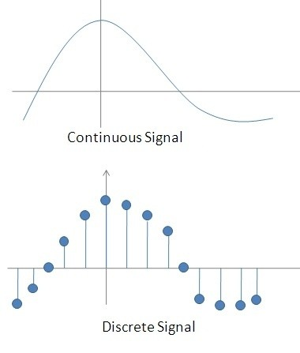
Attribute Classification
Discrete Attribute – has a countable set of values
Examples: zip codes, number of words,
Typically represented as integers
Continuous Attribute - has an infinite set of numbers and potential divisions
Example: temperature, height, weight
Typically represented as floating point (decimal)
https://qph.fs.quoracdn.net/main-qimg-7badb966d5ff6063ddb515737011ed1b-c

Slide 6
Important Attribute Classes
Categorical
Nominal - Data that can be counted, but not aggregated or ordered
Examples: Eye Color, Zip Code, Music Genre
Ordinal - Data that can be counted and ordered, but not aggregated.
Examples: Grades, Clothing Size, Positions (in a race)
Numerical
Interval (metrics) - The difference in values are constant and meaningful
Examples: The difference between a temperature of 100°F and 90°F is the same difference as between 90°F and 80°F.
Ratio - An interval scale with an absolute zero
Examples: Income, Height, Weight

Slide 7
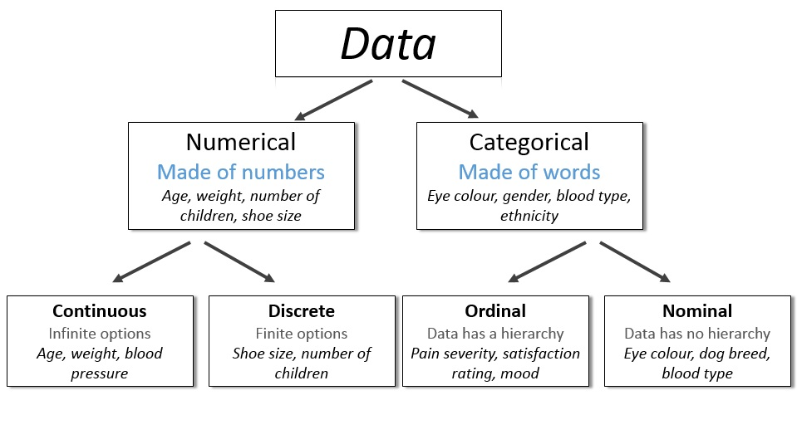
http://survivestatistics.com/variables/

Slide 8
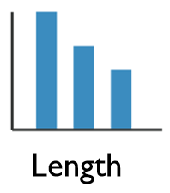
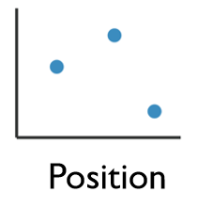
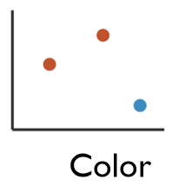
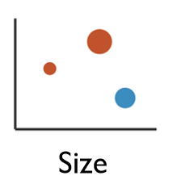
Enhancing Visualizations
1 Dimensional Data
Length
2 Dimensional Data
Position
2+ Dimensional Data
Position
Color Hue/Saturation
Size
Shape

Slide 9
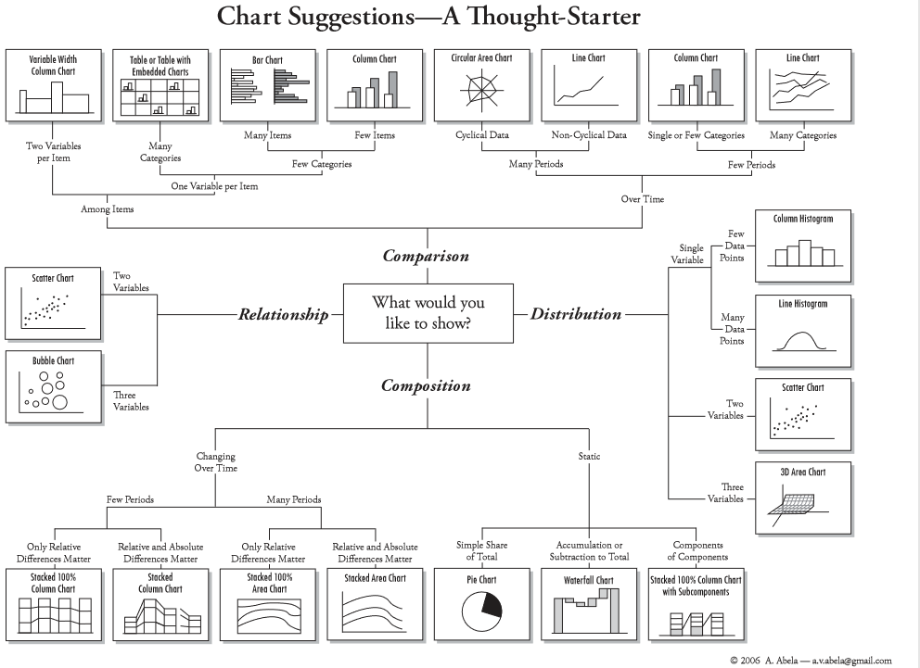
Four Basic Chart Types
http://extremepresentation.typepad.com/files/choosing-a-good-chart-09.pdf

Slide 10
Want to continue learning Tableau?
Lynda.com: (Free from UC):
Tableau Essential Training
Tableau 10 for Data Scientist
Creating Interactive Dashboards in Tableau 10
Library Workshops:
https://webapps2.uc.edu/ce/facdev/Workshops
And of course....Google/YouTube
UC Courses:
Data Analytics
Data Visualization

Slide 11

University of Cincinnati Libraries
Research & Data Services
AskData@uc.edu

Slide 12
Research & Data Services
What is RDS?
UC Libraries’ Research and Data Services (RDS) offers support and resources to enhance the productivity of UC researchers at all levels. We provide instruction, consulting, and collaborative spaces designed to deepen research insights. On West campus, we are located in the Geology-Math-Physics Library (Braunstein Hall).
Who can use your services? We provide our services to researchers in all disciplines and at all levels, including undergraduate students, graduate students, post-docs, and staff.
How can you help me? We provide research services that supports the entire life cycle of a research project from data acquisition through archival via instructional workshops, consultations, and research collaboration.

Slide 13













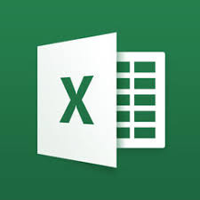

Data Visualization Software
Free:
Orange
QGIS
R
Python
Tableau (public)
Java-Script
D3
Leaflet
Chartist
Plotly
Cost:
Excel
Power BI (Microsoft
Tableau (Desktop)
SPSS
SAS
MATLAB
ArcGIS
Looker

Slide 14
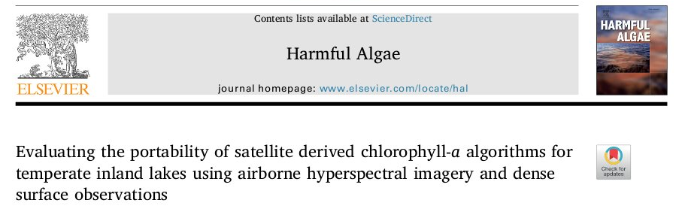
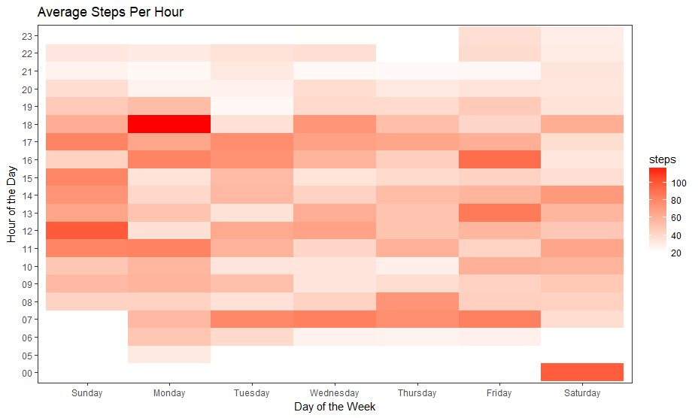
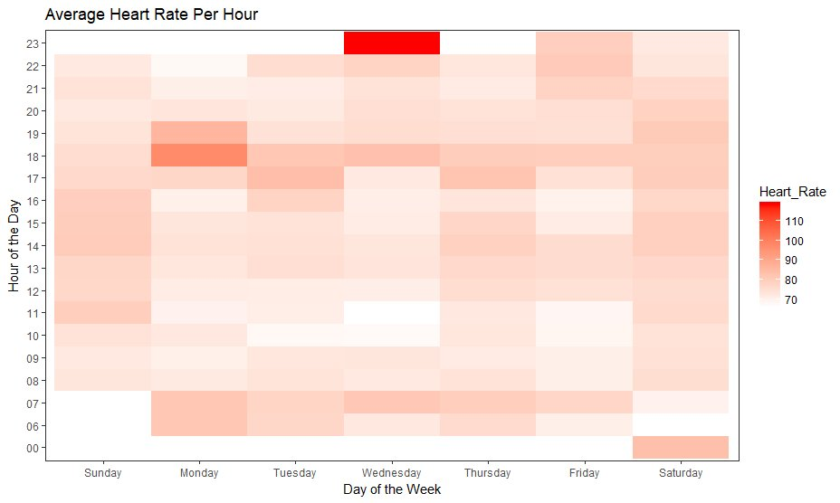
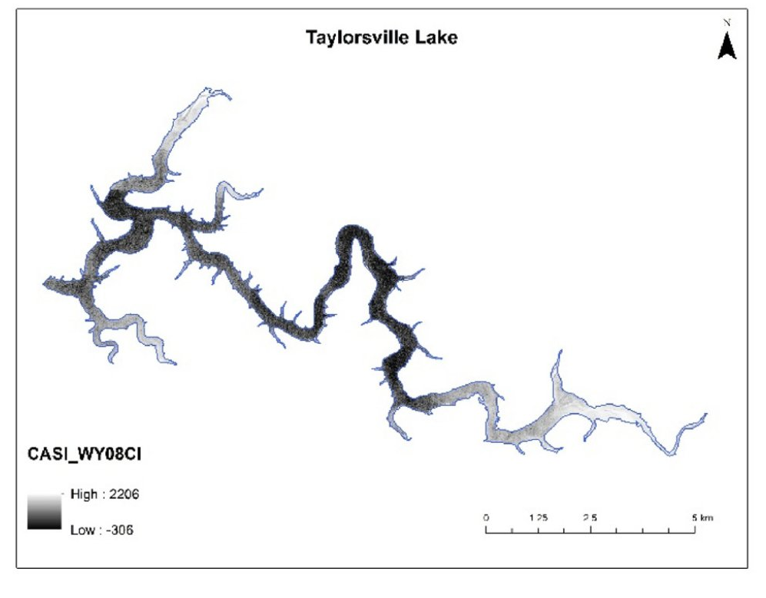
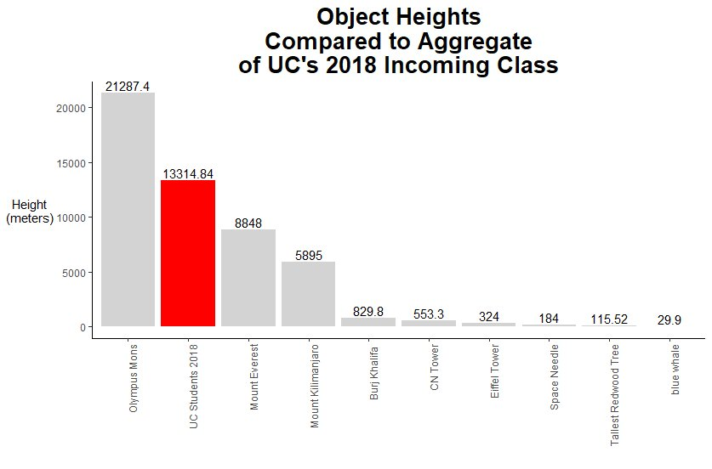
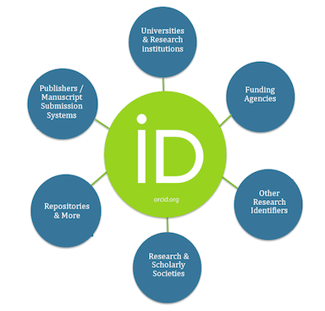
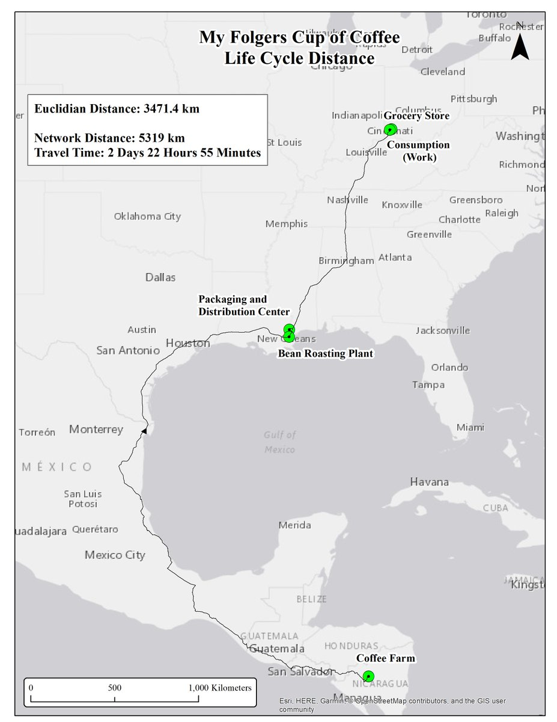
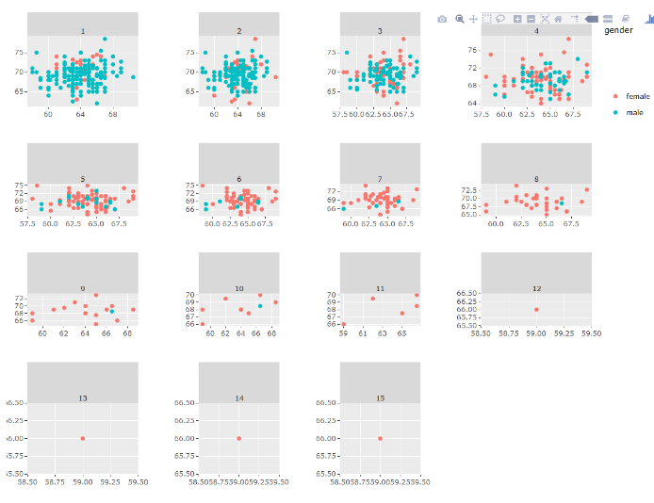
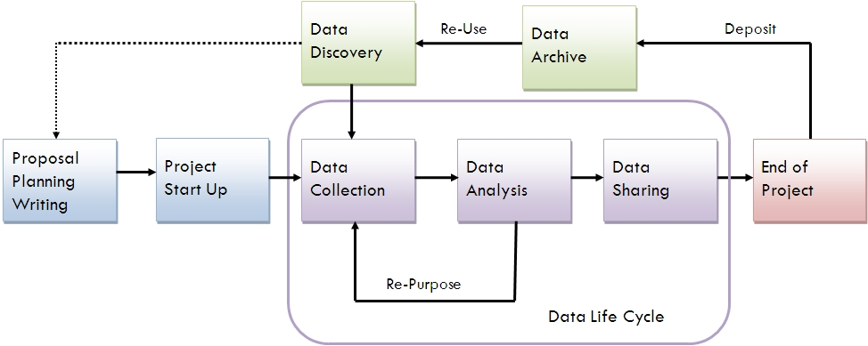
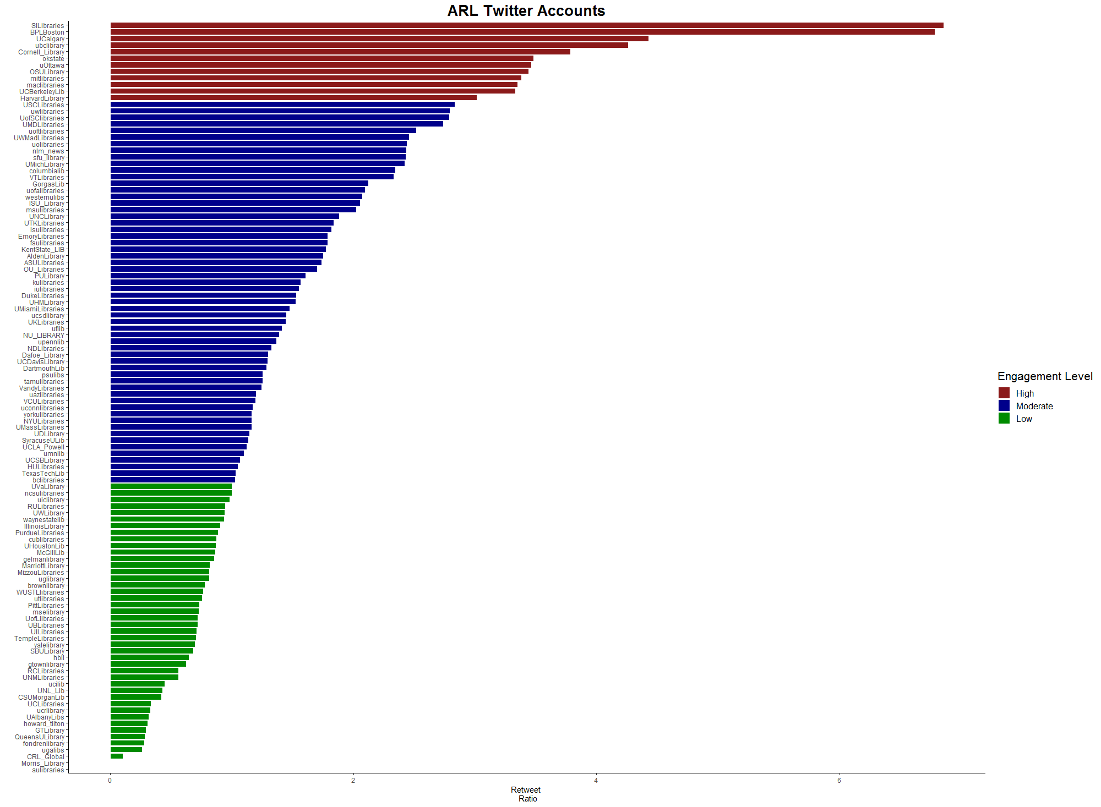
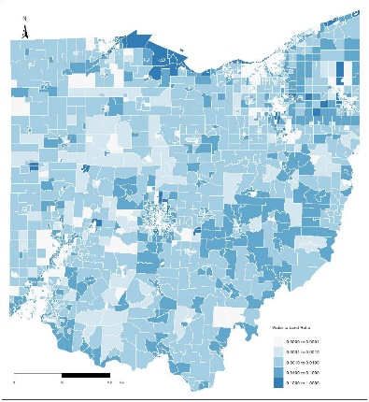




Projects
Source: http://data.library.virginia.edu/data-management/lifecycle/

Slide 15
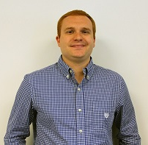

How to Contact Us:
Viz Lab Manager:
Richard Johansen, Data Visualization Specialist
GitHub: https://github.com/RAJohansen/
Twitter: @DataVizJohansen
Data & GIS Collab Manager:
Amy Koshoffer, Science Informationist
Email: AskData@uc.edu
Web: https://libraries.uc.edu/digital-scholarship/data-services.html
Visit: 240 Braunstein Hall (Geology-Math-Physics Library)

